Slide 1



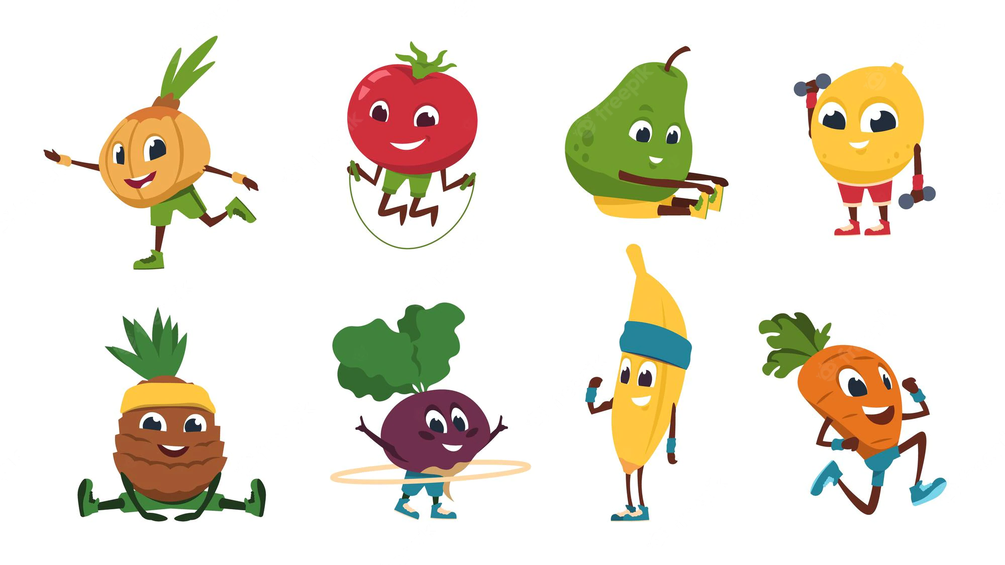




Week 1 | Monday | Tuesday | Wednesday | Thursday | Friday
OPTION 1 | Cauli-Power Curry (VE) | Caribbean Rice (VE) | Leek and Potato Pie with a Flaky Topping (V) | Butternut Squash Mac and Cheese (V) | Egg Muffin (V)
OPTION 2 | Crunchy Veggie Taco (VE) | Sticky Chicken Bites | Roast Gammon with All The Trimmings | Mild Chilli With Nachos & 50/50 Rice | Fish and Chips
Seasonal Vegetable | Peas and Sweetcorn | Wedges & Beans | Veg Medley with Mash Potato | Garden Peas | Baked Beans & Chips
Jacket Potatoes | Bean (VE) or Cheese (V) | Bean (VE) or Cheese (V) | Bean (VE) or Cheese (V) | Bean (VE) or Cheese (V) | Bean (VE) or Cheese (V)
Pick and Mix | Egg Mayo or Cheese Sandwich (V) | Ham Sandwich or Tuna Sandwich | Chicken or Egg Mayo Sandwich (V) | Ham or Cheese sandwich (V) | Tikka mayo or Cheese and Tomato sandwich (V)
Pudding | Fruity Pancake and Yoghurt (V) | Berry Oat Slice with Custard (V) | Jam Drop Biscuit (VE) | Chocolate Brownie with Chocolate Sauce (V) | Vanilla & Oat Muffin with Ice Cream (V)
Save The Planet Day
KEY
V VEGETARIAN
VE VEGAN
PLANT BASED AND PLANET FRIENDLY

Slide 2

Week 2 | Monday | Tuesday | Wednesday | Thursday | Friday
OPTION 1 | Sizzling Sausage Jambalya (VE) | Steamed Salmon and vegetable Noodles | Lentil Cottage Pie (VE) | Potato, Spring Onion and Chedder Frittata (V) | Cheese and Onion Puff with Chips (V)
OPTION 2 | Mushroom Stroganoff with 50/50 Rice (V) | Beef Bolognaise Bake | Winner Spinner Chicken Dinner | Healthy Hot Dogs | Fishfingers and Chips
Seasonal Vegetable | Garden Peas & Sweet corn | Garlic Bread & Salad | Veg Medley & Roast Potato | Wedges and Beans | Baked Beans & Chips
Jacket Potatoes | Bean (VE) or Cheese (V) | Bean (VE) or Cheese (V) | Bean (VE) or Cheese (V) | Bean (VE) or Cheese (V) | Bean (VE) or Cheese (V)
Pick and Mix | Egg Mayo or Cheese Sandwich (V) | Ham Sandwich or Tuna Sandwich | Chicken or Egg Mayo Sandwich (V) | Ham or Cheese sandwich (V) | Tikka mayo or Cheese and Tomato sandwich (V)
Pudding | Banana and Custard (V) | Treacle Sponge with Custard (V) | Gingerbread Cupcakes with Ice Cream (V) (V) | Chocolate Cornflake Cake (V) | Fruity Muffin with Milkshake (V)
Save The Planet Day
KEY
V VEGETARIAN
VE VEGAN
PLANT BASED and PLANET FRIENDLY

Slide 3
Week 3 | Monday | Tuesday | Wednesday | Thursday | Friday
OPTION 1 | Tomato Lentil Ragu (VE) | Forest Fajita (VE) | Winter Vegetable Slice (VE) | Pizza Pasta (V) | Golden Sausage Rolls (V)
OPTION 2 | Mighty Meatball Subs (VE) | Mild Chicken Curry | Savory Mince and dumpling | Breakfast Omelet | Chicken Strips & Chips
Seasonal Vegetable | Carrots and Potato Cubes | 50/50 Rice & Salad | Veg Medley & New Potato | Sweetcorn, Peas and Wedges | Baked Beans Chips
Jacket Potatoes | Bean (VE) or Cheese (V) | Bean (VE) or Cheese (V) | Bean (VE) or Cheese (V) | Bean (VE) or Cheese (V) | Bean (VE) or Cheese (V)
Pick and Mix | Egg Mayo or Cheese Sandwich (V) | Ham or Tuna Sandwich | Chicken or Egg Mayo Sandwich (V) | Ham or Cheese sandwich (V) | Tikka mayo or Cheese and Tomato sandwich (V)
Pudding | Rice Pudding (V) | Jam Sponge with Custard (V) | Banana Flapjack (VE) | Warm Spiced Apple Crumble with Custard (V) | Chocolate Cookie & Milkshake (V)
Save The Planet
Day
KEY
V VEGETARIAN
VE VEGAN
PLANT BASED AND PLANET FRIENDLY

